Slide 1
Visa Approval Prediction
18BCE0856 - Atharva Chaudhary
18BIS0032 - Ashwath A
18BCI0246 - Lakshit Mangla
18BEC0460 - T Yashwanth

Slide 2
Introduction
Over 2 Million visa petitions are filed by the employers each year and only 65000 petitions are approved. So, the goal is to explore the petitions filed and their outcomes for the past six years i.e., from 2011 to 2016, and to find a pattern to predict the outcome by using a predictive model developed using Machine Learning techniques.
Our goal is to predict the outcome of H-1B visa applications that are filed by many professional foreign nationals every year. Here, we framed the problem as a classification problem and applied it in order to output a predicted case status of the application. The input to our algorithm is the attributes of the applicant. H-1B is a type of non-immigrant visa in the United States that allows foreign nationals to work in occupations that require specialized knowledge and a bachelor’s degree or higher in the specific specialty.

Slide 3
Introduction
This visa requires the applicant to have a job offer from an employer in the US before they can file an application to the US immigration service (USCIS). We believe that this prediction algorithm could be a useful resource both for the future H-1B visa applicants and the employers who are considering sponsoring them.
In order to predict the case status of the applicants, we will be feeding the model with the dataset which contains the required fields by which the machine can classify the case status as certified or denied.

Slide 4
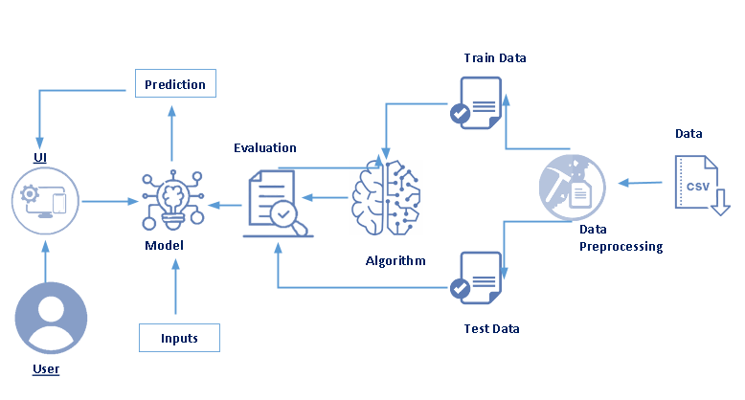
Block Diagram

Slide 5
Steps Involved
04
Data Pre-Processing
Flask Application
01
03
Build Model and Evaluate
Train and Test Data
02

Slide 6
Data Pre-Processing
First the dataset is read into the jupyter notebook. Missing data are found if any. The rows consisting of the null data under the output column are dropped from the dataset. Other columns where the data are missing, are replaced by the mean or mode of their respective columns. As it is a classification problem, the data for each output class should be equal. The classes are observed to have different numbers of rows and hence equal amounts of data are sampled for each class. The columns having categorical data are converted using One Hot Encoder.

Slide 7
Train and Test Data
Next step is to split the data into train and test data. For that, we need to identify the input columns which matters the most or which impacts the output. Four columns namely Soc Name, Full time position, prevailing wage and year are selected as input to the model. The output column is Case Status which will be the prediction of the model. The data for training is taken as 80% and for the test is taken as 20% randomly from the preprocessed dataset.

Slide 8
Build Model and Evaluate
The model is built using the keras library. At first, the neural network is added the input nodes which are equal to the number of input columns in the dataset with relu as the activation function. Further, hidden layers are added for increasing the accuracy of the model with relu activation function. At the final output layer, the number of nodes added are equal to the number of classes present in the Case Status columns with softmax as the activation function. After fitting the model with certain epochs, input values are given for prediction. Finally the model is saved.

Slide 9
Flask Application
A website is created for the user to input values and observe the output. Flask application is made in order to integrate the model with the website. The front-end is written in HTML and CSS while the back-end is programmed using python. A form is presented in the webpage and the user inputs their details. Once the form is submitted, the push request is handled by the application where the model predicts for the values given by the user, The resultant prediction is displayed in the website.

Slide 10
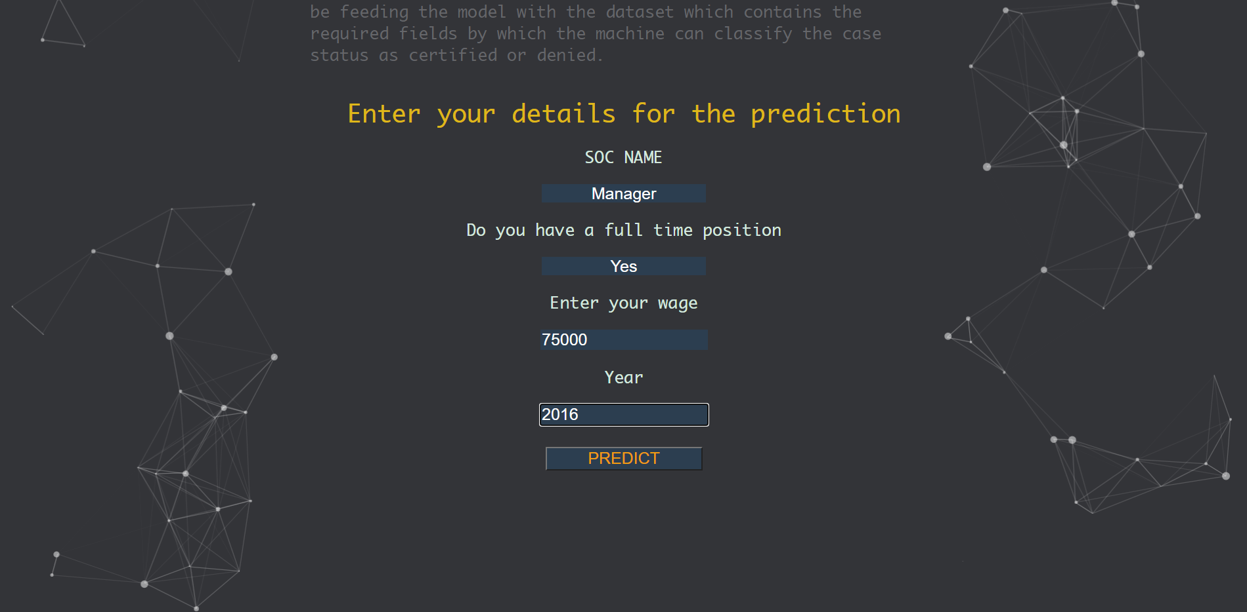
Output

Slide 11
Thank You!

